Slide 1
EXPLORATORY DATA ANALYSIS · TASK 1
What drives a
taxi fare?
Eight questions answered from 500,000 NYC taxi trips
Notes:
Title slide. This deck walks through the EDA notebook: the dataset, its quality issues, then the eight questions one by one.

Slide 2
The dataset
500,000
26
5
0
columns
missing values in 9 columns
duplicate rows
trips (rows)
Trips from 2009–2015 with fare, passenger count, pickup/dropoff coordinates, distances to airports, time features, plus Car Condition, Weather and Traffic Condition. The categorical columns are almost perfectly balanced; pickup_datetime still needs converting to a datetime.
Source: task_1_submission.ipynb
Notes:
The data is large and mostly clean at the structural level: negligible missing values, no duplicates, no constant columns.

Slide 3
Data quality issues found
Check | Records | Why it matters
Zero distance | 14,250 | Many still have a non-zero fare
Distance over 200 km | 1,004 | Up to ~12,000 km — impossible for a taxi ride
Fare over 100 for under 1 km | 93 | Likely entry errors or special charges
Negative fare | 21 | Physically impossible (as low as −44.90)
Zero fare | 14 | Suspicious for a completed trip
fare_amount: mean 11.36 · median 8.50 · skewness 4.90 · max 500
Notes:
These outliers were detected but not removed before answering the questions, so they add noise to several charts, especially Q7 and Q8.

Slide 4
Eight questions at a glance
Q1
Q2
Q3
Q4
Does passenger count raise the fare?
Does car condition affect the fare?
When are fares highest?
Does traffic affect the fare?
5 AM
No
No
No
Q5
Q6
Q7
Q8
Is distance the strongest predictor?
When are rides most requested?
Does weather change trip distance?
Are airport pickups pricier?
Yes
7 PM
No
Unclear
Notes:
The short version: only distance clearly moves the fare. Time of day shapes both fares and demand. Car condition, traffic, weather and passenger count barely matter.

Slide 5
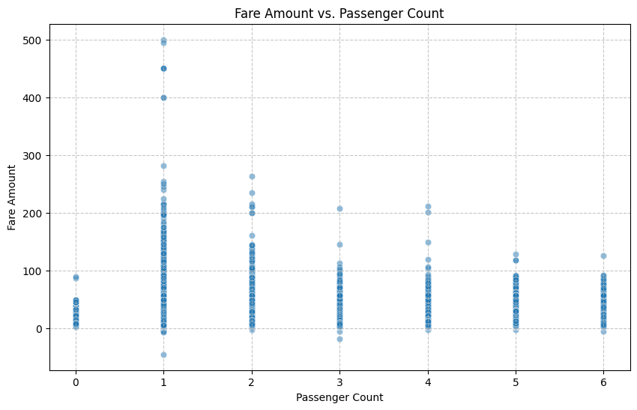
QUESTION 1
Is higher passenger count associated with a higher fare?
Answer
No
Fares spread similarly whether 1 or 6 people ride. The correlation between passenger_count and fare_amount is just 0.01.
Fare is priced per trip, not per person — passenger count adds almost no information.
Scatter plot · fare vs. passenger count
Q1 of 8 · NYC taxi fares EDA
Notes:
Fares spread similarly whether 1 or 6 people ride. The correlation between passenger_count and fare_amount is just 0.01. Fare is priced per trip, not per person — passenger count adds almost no information.

Slide 6
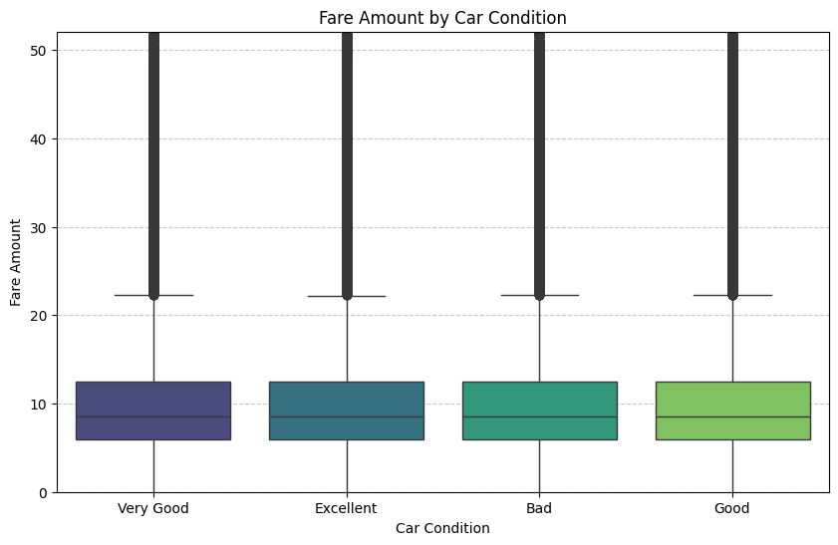
QUESTION 2
Does car condition influence the fare amount?
Answer
No
Median fare and spread are nearly identical across Bad, Good, Very Good and Excellent cars (~125k trips each).
Car condition is not a pricing factor in this data.
Box plot · fare by car condition (y capped at 99th pct.)
Q2 of 8 · NYC taxi fares EDA
Notes:
Median fare and spread are nearly identical across Bad, Good, Very Good and Excellent cars (~125k trips each). Car condition is not a pricing factor in this data.

Slide 7
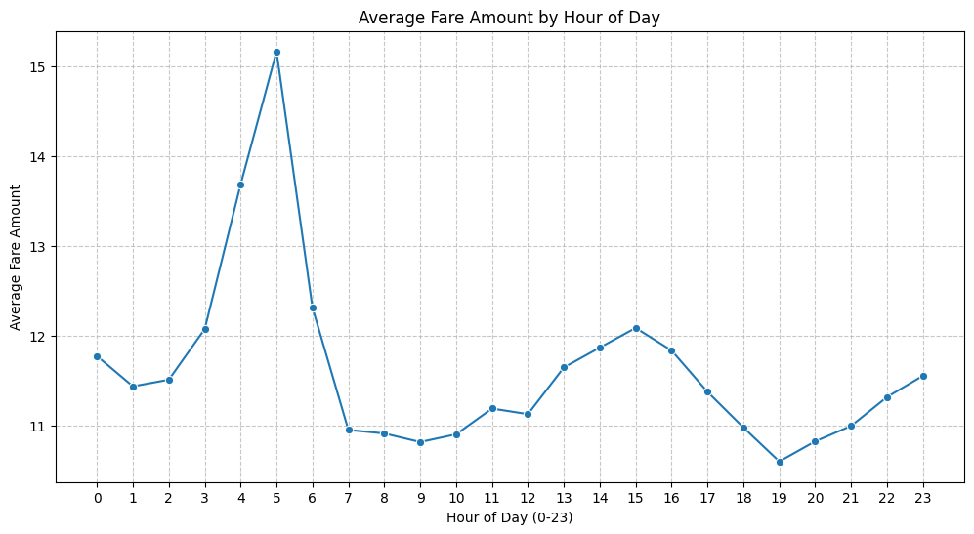
QUESTION 3
At what hour of the day are fares highest?
Answer
5 AM
The average fare peaks at about 15 at 5 AM, far above the rest of the day. The lowest average, about 10.6, is at 7 PM.
Note: the notebook text says fares peak at midnight and are lowest at 4–6 AM; the chart shows the opposite for early morning.
Line plot · average fare by hour
Q3 of 8 · NYC taxi fares EDA
Notes:
The average fare peaks at about 15 at 5 AM, far above the rest of the day. The lowest average, about 10.6, is at 7 PM. Note: the notebook text says fares peak at midnight and are lowest at 4–6 AM; the chart shows the opposite for early morning.

Slide 8
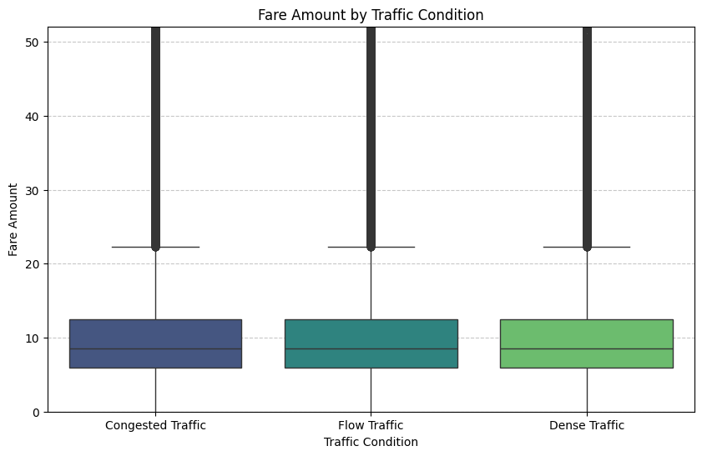
QUESTION 4
Does traffic condition affect the trip fare?
Answer
No
Flow, Dense and Congested traffic show the same median fare and a similar spread (~166k trips each).
Traffic labels do not shift fares in this dataset.
Box plot · fare by traffic condition (y capped at 99th pct.)
Q4 of 8 · NYC taxi fares EDA
Notes:
Flow, Dense and Congested traffic show the same median fare and a similar spread (~166k trips each). Traffic labels do not shift fares in this dataset.

Slide 9
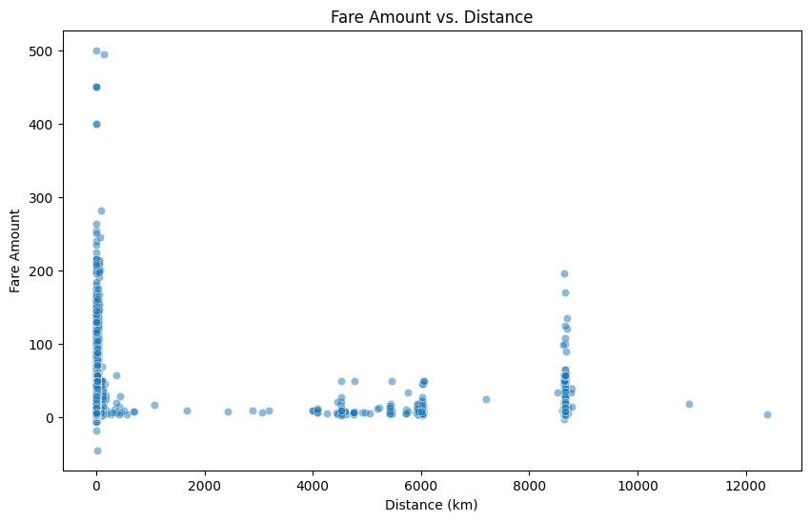
QUESTION 5
Is trip distance the strongest predictor of fare?
Answer
Yes
Distance has the highest correlation with fare_amount of any numeric feature: 0.61. The relationship is positive, but outliers blur it.
Outliers: fares up to 500 at near-zero distance, and distances above 8,000 km at low fares.
Scatter plot · fare vs. distance
Q5 of 8 · NYC taxi fares EDA
Notes:
Distance has the highest correlation with fare_amount of any numeric feature: 0.61. The relationship is positive, but outliers blur it. Outliers: fares up to 500 at near-zero distance, and distances above 8,000 km at low fares.

Slide 10
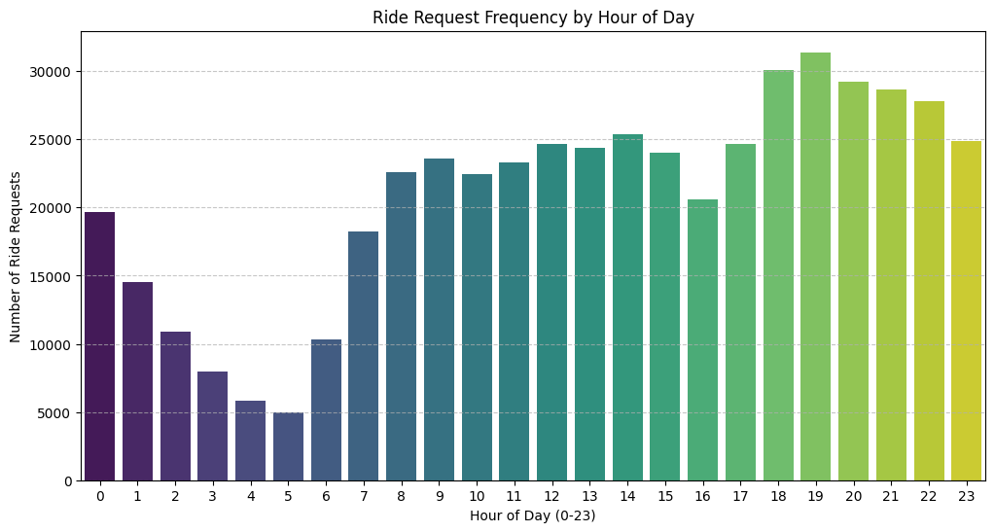
QUESTION 6
At what time of day are ride requests most frequent?
Answer
7 PM
Demand builds through the day and peaks in the evening, 6–10 PM, topping out at about 31,000 requests at 7 PM. It bottoms out at 5 AM (~5,000).
Compare with Q3: the quietest hour (5 AM) is also the most expensive one on average.
Count plot · ride requests by hour
Q6 of 8 · NYC taxi fares EDA
Notes:
Demand builds through the day and peaks in the evening, 6–10 PM, topping out at about 31,000 requests at 7 PM. It bottoms out at 5 AM (~5,000). Compare with Q3: the quietest hour (5 AM) is also the most expensive one on average.

Slide 11
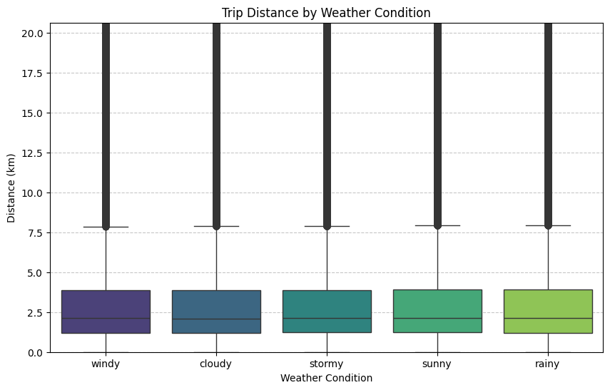
QUESTION 7
Does weather influence the average trip distance?
Answer
No
Median trip distance is about 2 km under all five conditions: sunny, cloudy, rainy, windy and stormy.
People travel the same distances whatever the weather.
Box plot · distance by weather (y capped at 99th pct.)
Q7 of 8 · NYC taxi fares EDA
Notes:
Median trip distance is about 2 km under all five conditions: sunny, cloudy, rainy, windy and stormy. People travel the same distances whatever the weather.

Slide 12
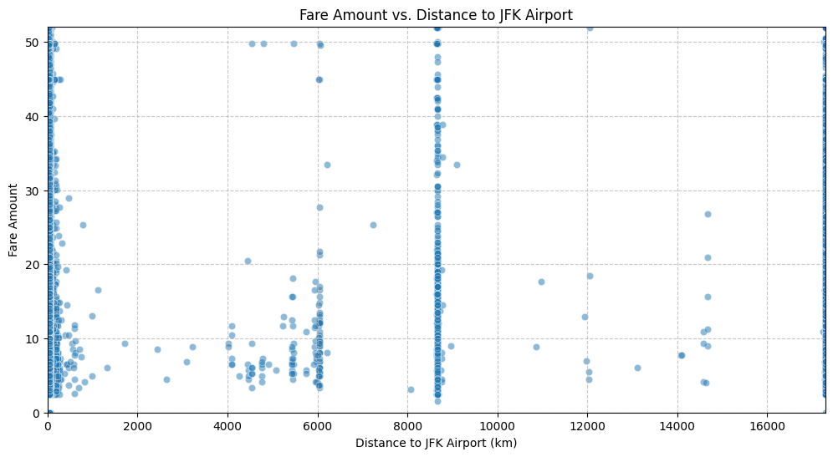
QUESTION 8
Are rides that start closer to airports more expensive?
Answer
Unclear
Fare vs. distance to JFK shows no clear trend: fares vary widely at every distance. Proximity to JFK alone is not a main driver of fare.
Caveat: the chart is dominated by bad coordinates (JFK distances in the thousands of km); re-check after cleaning.
Scatter plot · fare vs. distance to JFK
Q8 of 8 · NYC taxi fares EDA
Notes:
Fare vs. distance to JFK shows no clear trend: fares vary widely at every distance. Proximity to JFK alone is not a main driver of fare. Caveat: the chart is dominated by bad coordinates (JFK distances in the thousands of km); re-check after cleaning.

Slide 13
Key takeaways
Distance is the fare
Time matters
The only strong driver (r = 0.61). Build any fare model around it.
Fares peak at 5 AM; demand peaks at 7 PM. The hour is worth keeping as a feature.
Labels don’t move price
Clean before modelling
Car condition, traffic, weather and passenger count show no real effect.
Remove negative/zero fares, zero and >200 km distances, and bad coordinates.
Notes:
Wrap-up: one strong numeric driver, clear time-of-day patterns, flat categorical features, and a cleaning step needed before any modelling.

